Slide 1

CA3 –Infrastructure and Bigdata
Name: Abhilash J Antony
Student No. C00278716

Slide 2




Slide 3
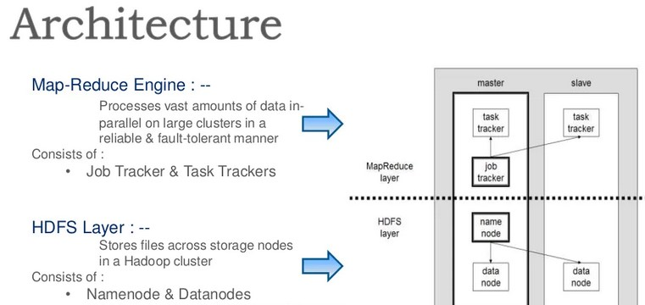

Slide 4
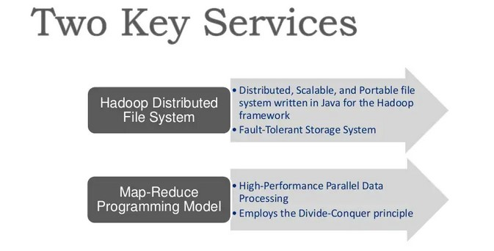

Slide 5
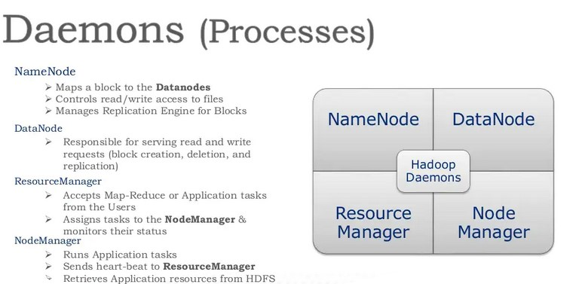

Slide 6
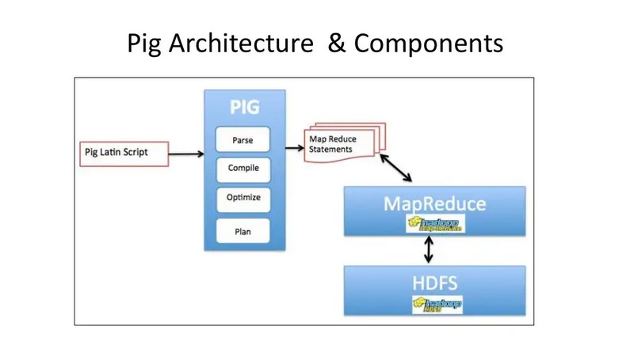

Slide 7
